Slide 1
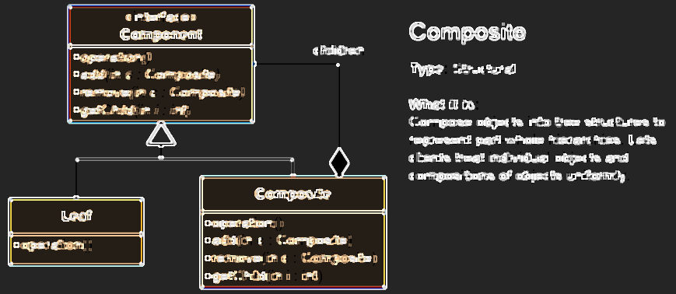
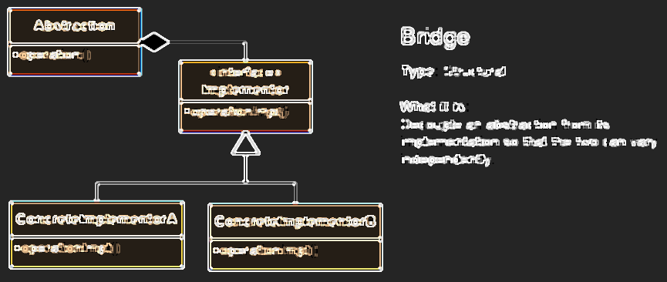
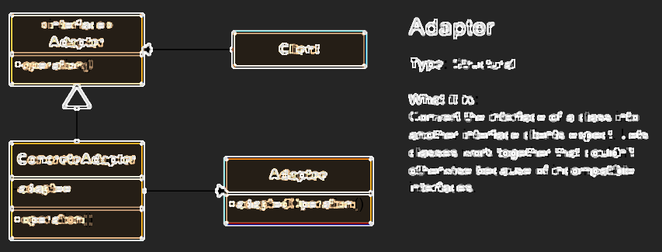

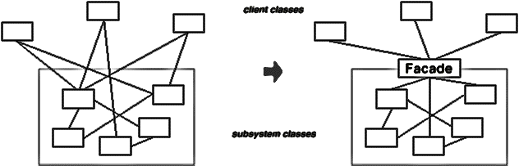
Structural Patterns
Design Patterns that ease the design by identifying a simple way to realize relationships between entities.
Antony Jekov
Academy Intern
http://jekov.telerik-students.org
Telerik Software Academy
academy.telerik.com

Slide 2
Structural Patterns
Describe ways to assemble objects to implement a new functionality
Ease the design by identifying a simple way to implement relationships between entities
This design patterns are all about Class and Object composition
Structural class-creation patterns use inheritance to compose interfaces
Structural object-patterns define ways to compose objects to obtain new functionality

Slide 3
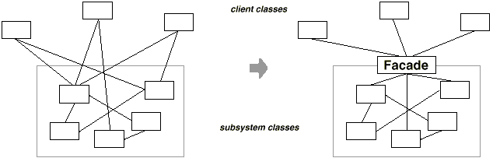
Facade Pattern
To deliver convenient interface from higher level to group of subsystems or single complex subsystem
Façade pattern used in many Win32 API based classes to hide Win32 complexity

Slide 4
Facade – Real World Example
The hard way:
popper.On();
popper.Pop();
amp.On();
amp.SetSurroundSound();
amp.SetVolume(10);
amp.SetDvd(dvd);
screen.Down();
lights.Dimm(20);
projector.On();
projector.WideScreenMode();
dvd.On();
dvd.Play("Dzift");
The facade way
homeTheater.WatchMovie("Dzift");

Slide 5
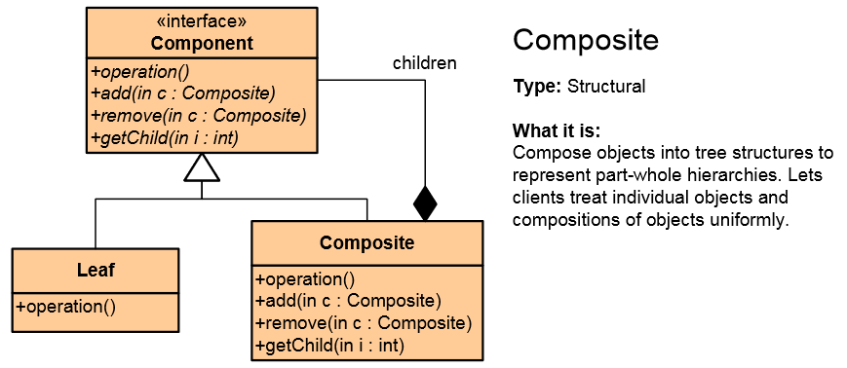
Composite Pattern
Composite Pattern allows to combine different types of objects in tree structures
Gives the possibility to treat the same individual objects or groups of objects
Used when
You have different objects and you want to treat them the same way
You want to present hierarchy of objects

Slide 6
Composite Pattern – Example
abstract class Shape {
public abstract void Draw();
}
class ConcreteShape : Shape {
public override void Draw() { /*...*/ }
}
class ComplexShape : Shape {
private List<Shape> ownedShapes;
public override void Draw() { /*...*/ }
}
class Line : Shape { public override void Draw() { ... } }
static void Main() {
var rootShape = new ComplexShape();
/* ... */
}

Slide 7
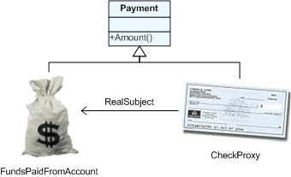
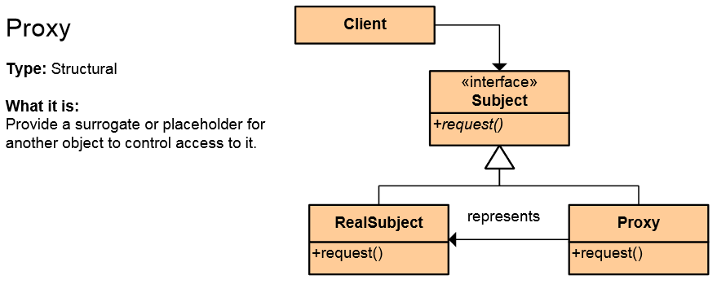
The Proxy Pattern
An object representing another object
Provide a surrogate or placeholder for another object to control access to it
Use an extra level of indirection to support distributed, controlled, or intelligent access
Add a wrapper and delegation to protect the real component from undue complexity
Example: Web Service

Slide 8
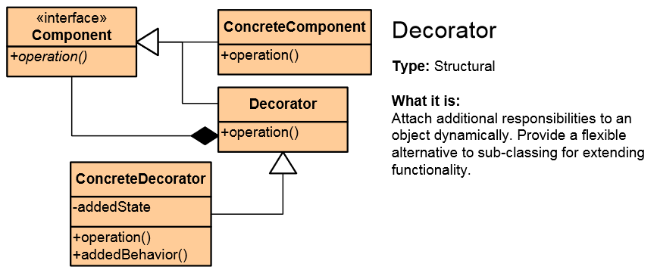
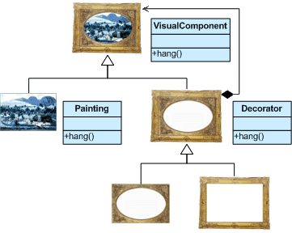
Decorator Pattern
Add responsibilities to objects dynamically
Wrapping original component
Alternative to inheritance (class explosion)
Support Open-Closed principle
In .NET: CryptoStream decorates Stream

Slide 9
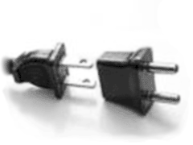
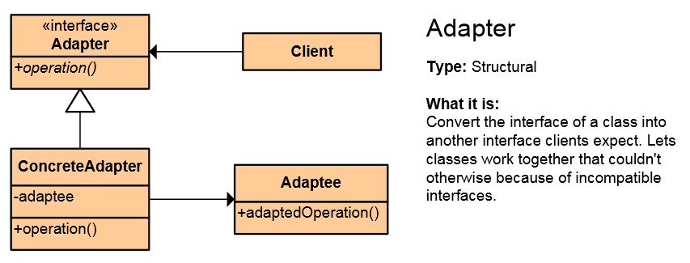
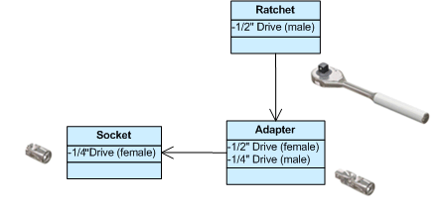
Adapter Pattern
Converts the given class' interface into another class requested by the client
Wrap an existing class with a new interface
Impedance match an old component to a new system
Allows classes to work together when this is impossible due to incompatible interfaces

Slide 10
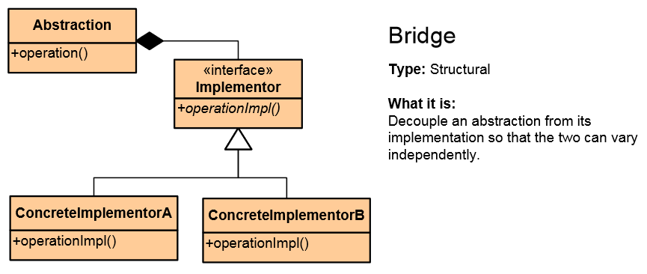

Bridge Pattern
Used to divide the abstraction and its implementation (they are by default coupled)
That way both can be rewritten independently
Solves problems usually solved by inheritance
From: Abstraction -> Implementation To: Abstraction -> Abstraction -> Implementation

Slide 11
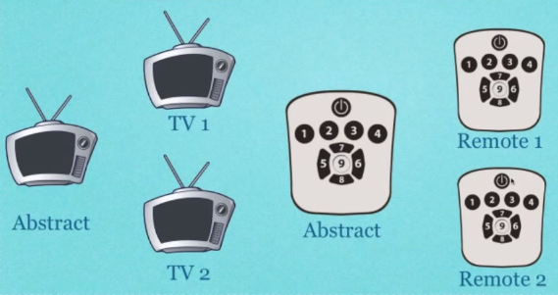
Bridge Pattern
Bridge Example

Slide 12
Proxy vs. Decorator vs. Adapter vs. Bridge
Proxy – to lazy-instantiate an object, or hide the fact that you're calling a remote service, or control access to the object (one-to-one interface)
Decorator – to add functionality to an object runtime (not by extending that object's type)
Adapter – to map an abstract interface to another object which has similar functional role, but a different interface (changes interface for the client)
Bridge – define both the abstract interface and the underlying implementation. I.e. you're not adapting to some legacy or third-party code, you're the designer of all the code but you need to be able to swap out different implementations (all changeable)

Slide 13
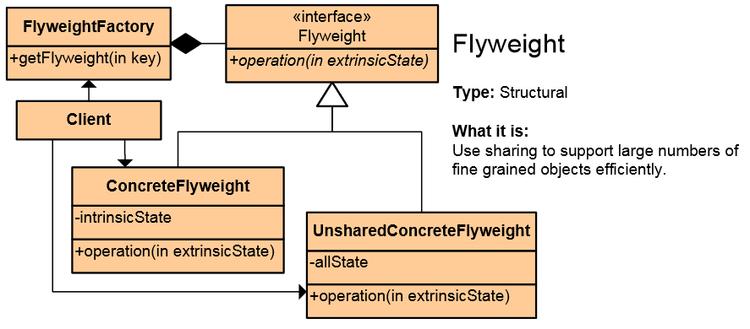
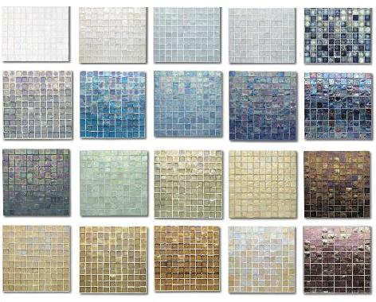
Flyweight Pattern
Use sharing to support large numbers of fine-grained objects efficiently
Reduce storage costs for large number of objects
Share objects to be used in multiple contexts simultaneously
Retain object oriented granularity and flexibility

Slide 14
Design Patterns
http://academy.telerik.com

Slide 15




Free Trainings @ Telerik Academy
C# Programming @ Telerik Academy
csharpfundamentals.telerik.com
Telerik Software Academy
academy.telerik.com
Telerik Academy @ Facebook
facebook.com/TelerikAcademy
Telerik Software Academy Forums
forums.academy.telerik.com

